Slide 1

Chapter : 04
Course Title: Assembly Language Lab
Course Code : CSE231L
Topic: Assembly Language Statements

Slide 2
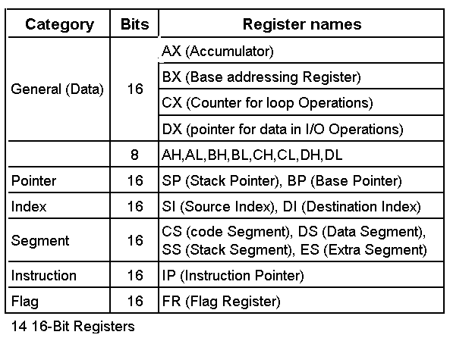
Registers of the 8086/80286
Thanjida Akhter

Slide 3
Assembly Language Statements
Assembler Directive | Instruction
main proc model small end main | mov cx, 5 Add ax, bx
What is different between Assembler Directive and Instruction?
Thanjida Akhter

Slide 4
Statements Field
Name | Operation | Operand(S) | Comments
Start: | MOV | CX, 5 | ;initialize counter
Thanjida Akhter

Slide 5
Naming Convention
Variable, Constant, Function/Procedure, Label, Macro
Name length (1-31) character.
Digits cannot be used at first.
Permissible characters:
(A-Z), ( a-z), (0-9), (? . @ - $ %)
.(dot) must be used at first.
Thanjida Akhter

Slide 6
Data type
Pseudo-op | Meaning | Byte | Bit
DB | Define Byte | 1 | 8
DW | Define Word | 2 | 16
DD | Define Double Word | 4 | 32
DQ | Define Quad Word | 8 | 64
DT | Define Ten Bytes | 10 | 80
Thanjida Akhter

Slide 7
Initialize
C | Assembly
int x=10; | x DW 10
int y; | y DW ?
char c=‘a’; | c DB ‘a’
Al=4; | Mov AL, 4
AL=BL; | Mov AL, BL
Thanjida Akhter

Slide 8
Assembly Expression
A = B - Y | X = 2B + U
MOV AL, B SUB AL, Y MOV A, AL | MOV AL, B ADD AL, AL ADD AL, U MOV X, AL
Thanjida Akhter

Slide 9
Increment & decrement operator
Name | keyword | Before | After
Increment | INC | AX=5 | 6
Decrement | DEC | AX=8 | 7
XCHG | XCHG AL, BL | AL=7 BL=4 | AL=4 BL=7
Thanjida Akhter

Slide 10
Function
Single Character Input | Single Character Output | String Output | DOS Exit
Function-1 | Function-2 | Function-9 | Function-4CH
MOV AH, 1 INT 21H | MOV AH, 2 MOV DL, AL INT 21H | MOV AH, 9 LEA DX,X INT 21H | MOV AH, 4CH INT 21H
*INT=Interrupt
*LEA= Load effective address
Thanjida Akhter

Slide 11
Memory Model
Model | Description
Small | CS=1 DS=1
Medium | CS>1 DS=1
Compact | CS=1 DS>1
Large | CS>1 DS>1 [No array large than 64k byte]
Huge | CS>1 DS>1 [Array may be large than 64k byte]
*CS=Code Segment, DS=Data Segment
Thanjida Akhter

Slide 12
Program Structure
.model small .stack 100h .data .code main proc main endp end main | ;Data definitions go here ;Instruction go here ;Other procedures go here
Thanjida Akhter

